Slide 1

HEA RT FAILURE DATA ANALYSIS by: Team 2
Shariq Khatri
Deniza Robinson
Jennifer Mancheno
Adaeze Mpyisi
Siawash Ahmar
Selina Taleb

Slide 2



Dataset Introduction
By: Shariq

Slide 3


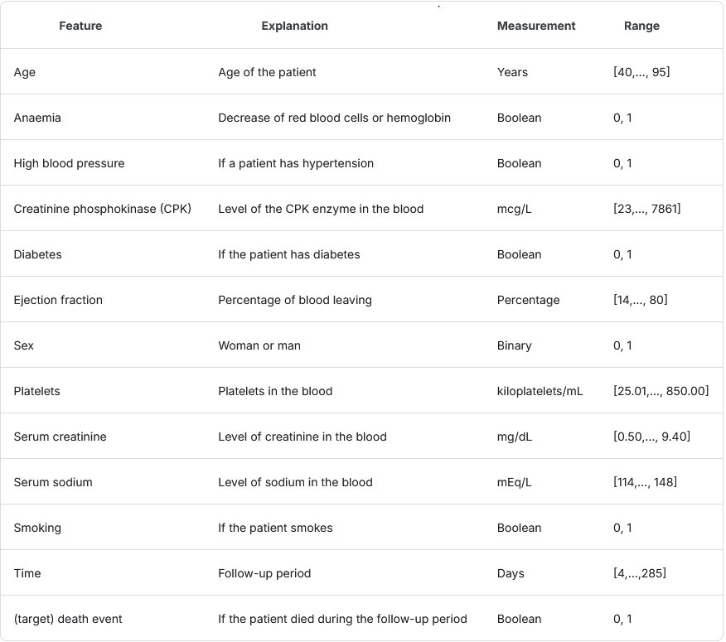

DATASET FEATURES:

Slide 4
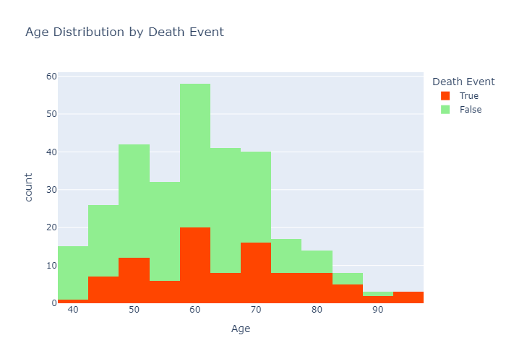
Age distribution by death event
Majority of the study is done with participants between the age of 50-80.
Cardiovascular Disease (CVD) Screening starts as early as 45.
Dataset may contain a bias toward older people.

Slide 5
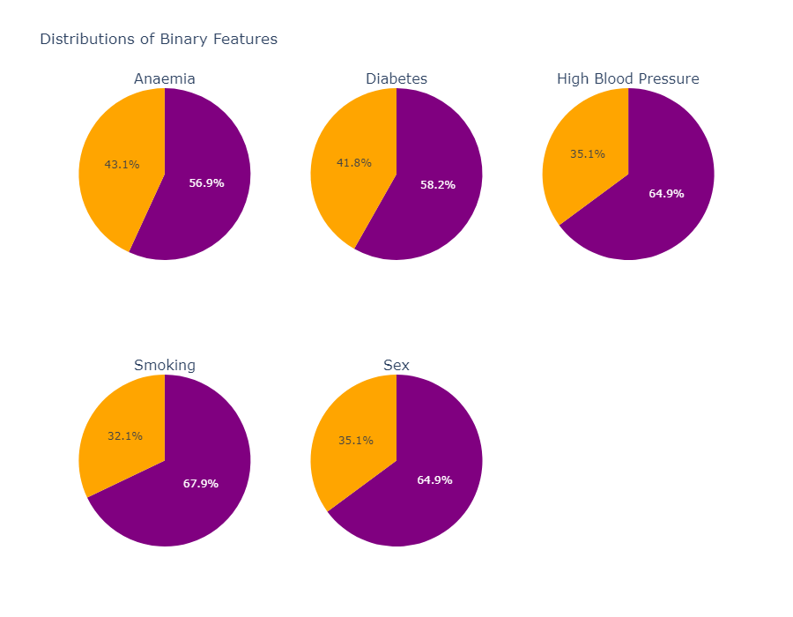
Distribution of binary features
Y
Y
Y
N
N
N
As the distribution of responses for YES is over 50% in all cases, this strongly suggests that the participants in this study have a higher prevelance of risk factors associated with CVD.
Dataset not a good recommendation for 'general population', however it might be a good representation of a 'high risk' population.
N
M
Y
F

Slide 6
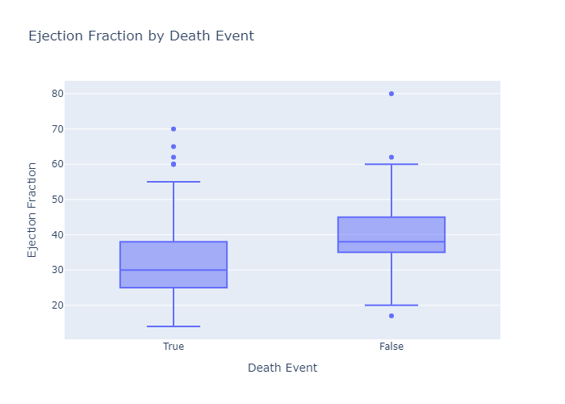
Ejection fraction by death event
Lower Ejection Fractions Linked to Mortality:
Death events are associated with significantly reduced ejection fractions compared to survivors.
Median ejection fraction among death events falls below the clinical threshold for heart failure.
Visual Insight from Boxplot:
Clear separation in ejection fraction distributions between survivors and non-survivors.
Greater variability and lower range for individuals who experienced death events.
Clinical Relevance:
Ejection fraction serves as a critical indicator of heart function and CVD prognosis.
Highlights the importance of early detection and management of reduced ejection fraction.
Actionable Insights:
Reinforce the need for monitoring ejection fraction in high-risk populations.
Develop targeted interventions for individuals with low ejection fractions to reduce mortality risk.

Slide 7
Financial
Analysis
BY: JENNIFER MANCHENO

Slide 8
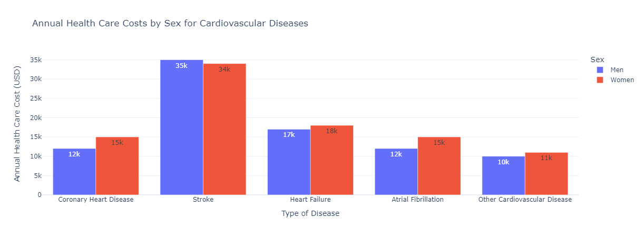
ANNUAL cvd HEALTHCARE COSTS BY SEX
Strokes have the highest costs for both genders
Women have higher costs in all conditions compared to men
The other cardiovascular diseases costs are lowest for both genders

Slide 9
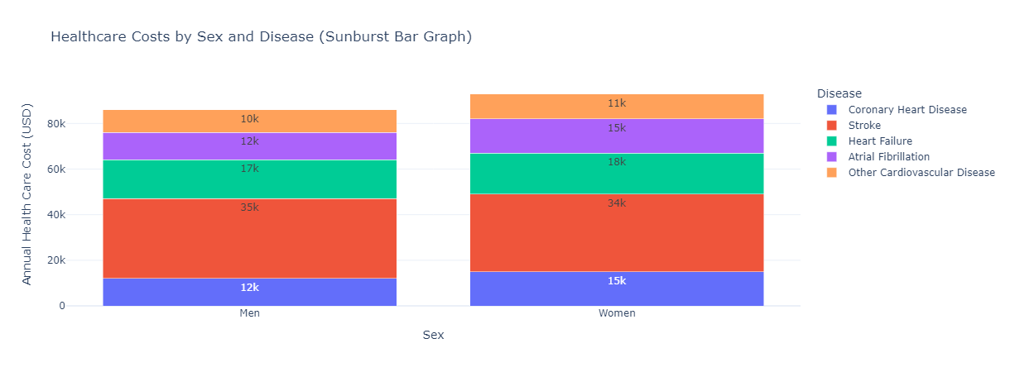
Healthcare costs by sex and disease
Stroke has the highest cost for both sexes
Women have higher annual cardiovascular disease costs

Slide 10
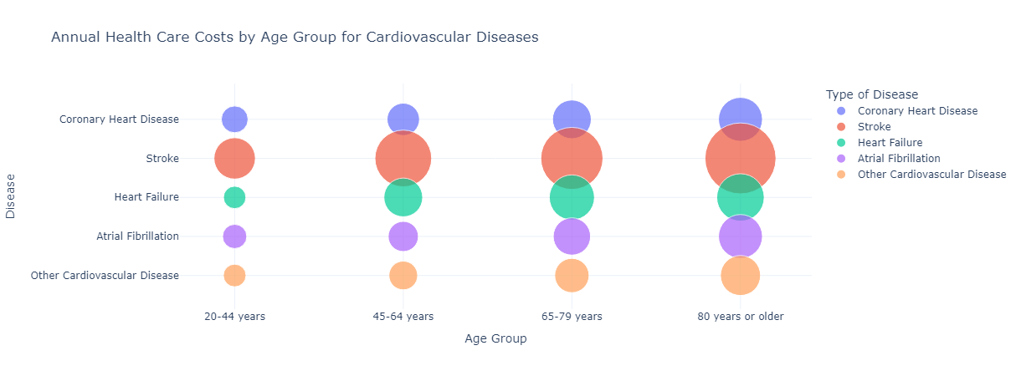
ANNUAL CVD HEALTHCARE COSTS BY AGE
Costs significantly increase with age, peaking in the 80 yrs. or older group, for all conditions
Strokes incur the highest costs, especially in older age groups
There are relatively lower healthcare costs for all conditions in younger age groups

Slide 11
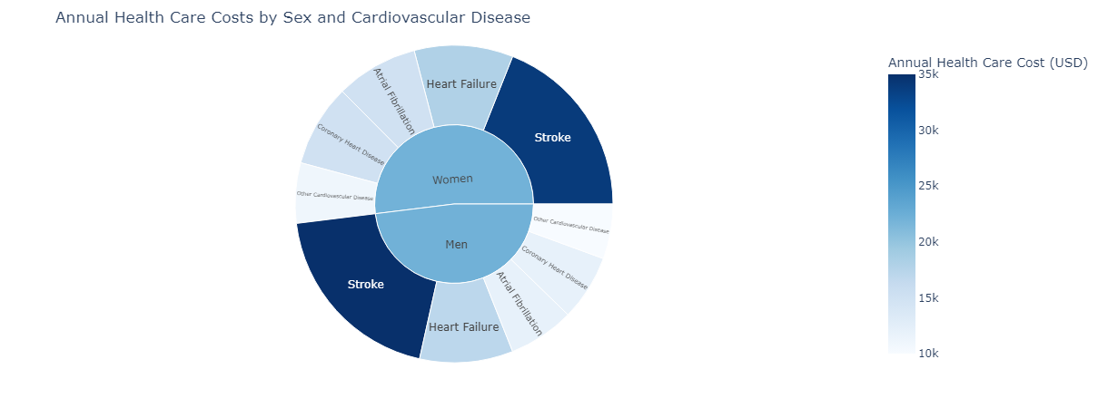
Proportion of cardiovascular diseases by sex
Strokes are the costliest conditions dominating the chart for both genders
Woman incur higher costs than men for most conditions
The smallest share of costs for both sexes contribute to other cardiovascular diseases
BEING ABLE TO PREDICT HEARTRATE FAILURE CAN HELP SAVE LIVES AND SIGNIFICANTLY REDUCE STRESS ON THE HEALTH CARE SYSTEM

Slide 12
Logistic Regression
By: Selina & Deniza

Slide 13

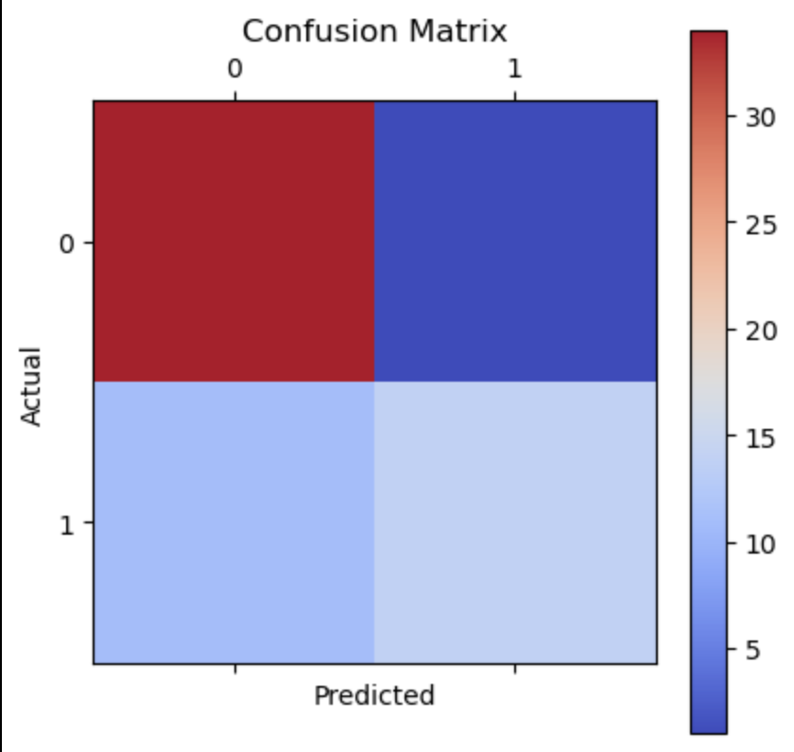
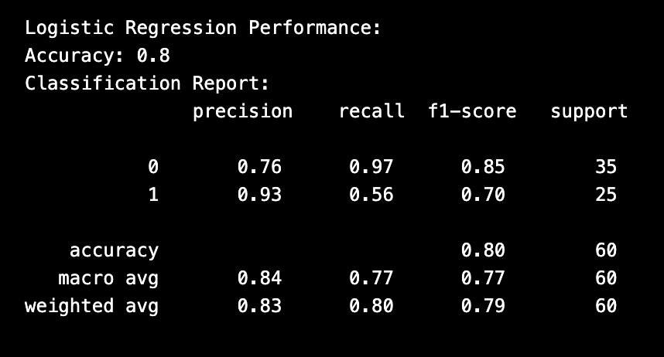
Logistic Regression: Predicting Death

Slide 14
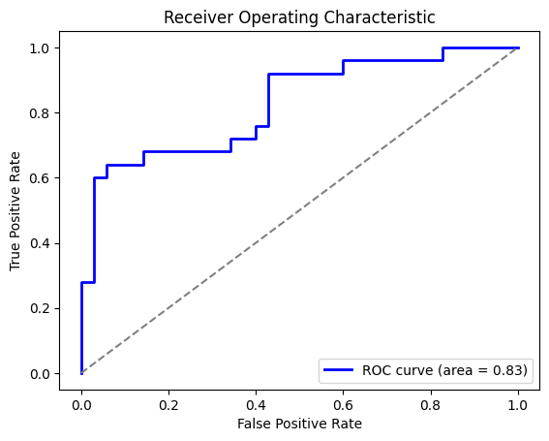
Receiver operating characteristic
X-axis (FPR): False positives (survivors incorrectly classified
as death events).
Y-axis (TPR): True positives (correctly identified death events).
Diagonal Line: Random guessing baseline.
Model Performance:
AUC = 0.83: Strong predictive power (83% accuracy in
distinguishing deaths vs. survivors).
Key Insight: The model effectively identifies high-risk
heart failure patients.
Takeaway: The ROC curve and high AUC indicate the model's
reliability, supporting better clinical decision-making for
heart failure outcomes.

Slide 15
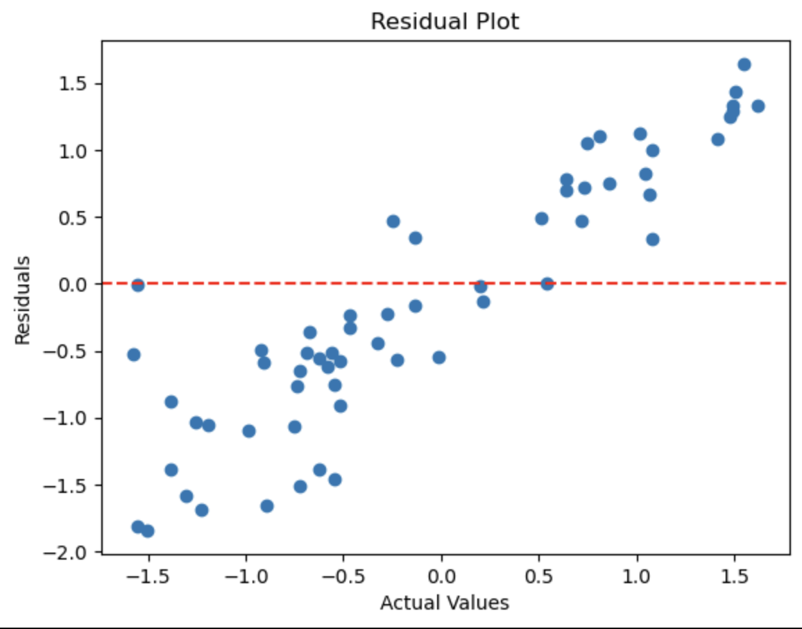
Linear Regression: Predicting Survival Time
Objective: predict survival time as a continuous variable using clinical features
MSE (Mean Squared Error): 0.93
R² (Coefficient of Determination): -0.02 (indicating the model performs worse than the mean prediction)
Residual plot demonstrating non-random patterns.

Slide 16
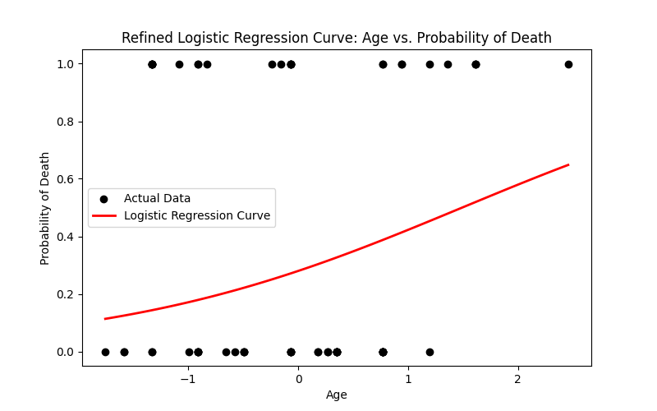
Age vs. Death Probability: Logistic Regression Curve
Objective: Visualize the relationship between age and the probability of death (DEATH_EVENT).
Logistic regression curve showing age (X-axis) vs. probability of death (Y-axis).
Simplified the model to focus only on age to reduce noise and generate a smoother logistic regression curve.
Positive correlation: as age increases, the probability of death also increases.

Slide 17
Neural network model
By: Siawash Ahmar

Slide 18
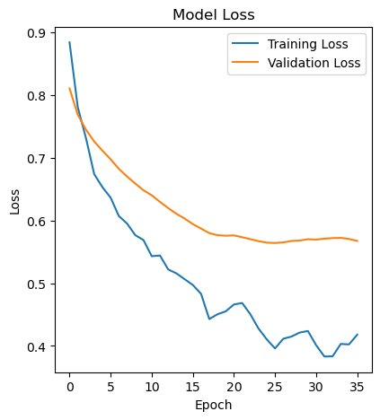
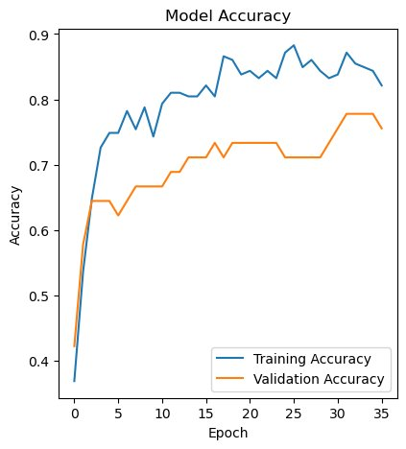

Neural Network model
Hyperparameters:
# of Neurons and Layers
Input L1: 50; L2: 100; Output L3: 1
5,851 parameters
Activation Functions
L1: Relu L2: Relu L3: Sigmoid
Number of Epochs
20
Accuracy: 88%
Loss: 35.5%
Verified that the dataset contained no categorical data.
Split the dataset into training and testing sets.
Scaled and standardized each feature using StandardScaler.
Created a sequential model for the neural network.
Fitted the model to the training data for training.

Slide 19
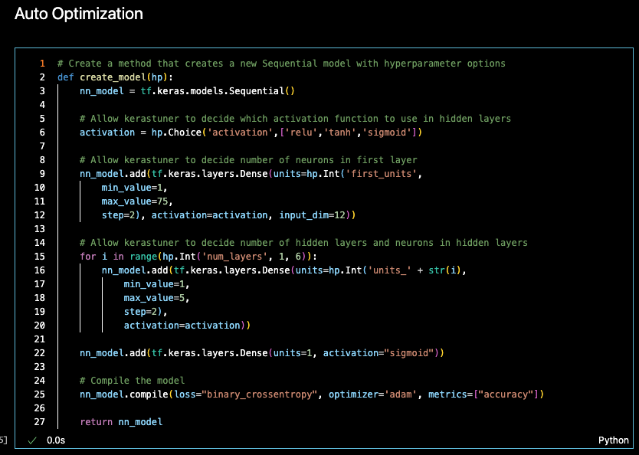
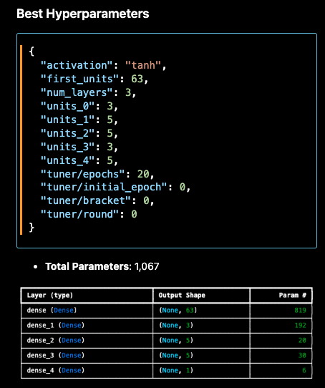
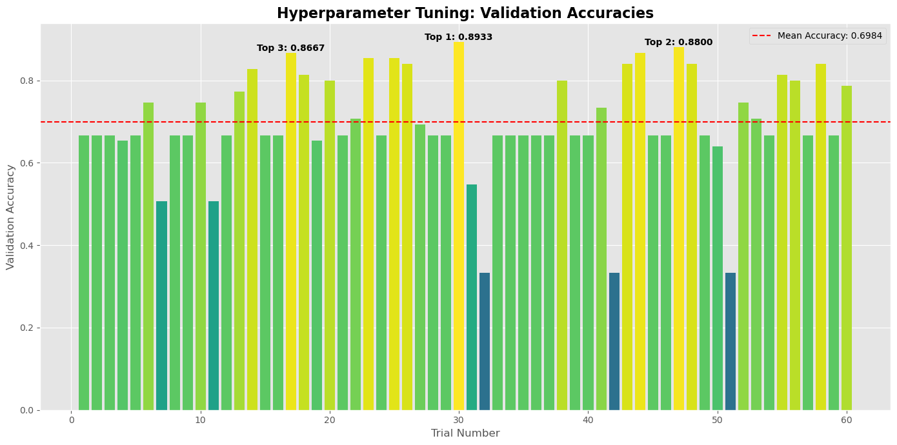
Neural Network Model: Auto Optimization
Auto Optimization
Method "borrowed" from class with key changes to input_dim, number of neurons and layers
Kerastuner used to determine best hyperparameters
Conclusion:
The model achieved a test accuracy of 89.3% through combination of automated and manual tuning
Model show promise and an INITIAL screening tool
Recommended next steps include:
Expanding the training dataset to improve model robustness.
Integrating related datasets to introduce new features that may enhance predictive performance.

Slide 20
Gradient boosting analysis
By: Adaeze mpyisi

Slide 21


Gradient boosting classifiers - intro
Gradient Boosting is a popular boosting algorithm in machine learning used for classification and regression tasks.
Boosting is one kind of ensemble Learning method which trains the model sequentially and each new model tries to correct the previous model. It combines several weak learners into strong learners
The two most popular boosting algorithm i.e.
AdaBoost
Gradient Boosting
Some advantages:
Combines weak learners like decision trees to make a more powerful model
Not a black box model – transparency in decision making
Source: https://www.geeksforgeeks.org/ml-gradient-boosting/

Slide 22
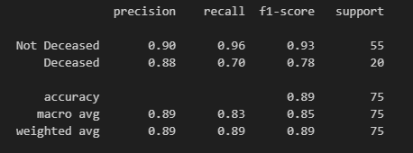
Sklearn – gradient boosting classifier
Classification report
Accuracy
Model 89% accurate at predicting if a patient was deceased
Precision
90% of predicted no-deaths were correct
88% of predicted deaths were correct
Recall
Ratio of correctly predicted no-deaths to the total no-deaths is 96%
Ratio of correctly predicted deaths to the total deaths is 70%

Slide 23
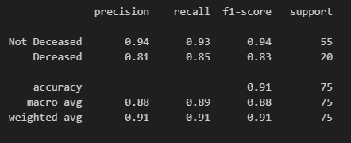
Xgboost - (eXtreme Gradient Boosting)
Classification report
Accuracy
Model 91% accurate at predicting if a patient was deceased
Precision
94% of predicted no-deaths were correct
81% of predicted deaths were correct
Recall
Ratio of correctly predicted no-deaths to the total no-deaths is 93%
Ratio of correctly predicted deaths to the total deaths is 83%
In conclusion, even though both libraries are used to train gradient boosting classifier models, XGBOOST was a far better fit for our data set. It was able to more accurately predict both death and non-death events

Slide 24

Thank you for listening!
Questions & Answers

